Slide 1

Presented By Ahsanul Haque Milon
Supply chain Analyst | Data Analyst

Slide 2
Introduction
This is a brief supply chain analysis on the company DataCo Global.
Shipping Modes (Days for shipment scheduled):
Standard Class (4 Days)
Second Class (2 Days)
First Class (1 Day)
Same Day (0 Day)
It is assumed that the fee is higher for a shipping mode with a shorter days for shipped scheduled.
In this project, the shipping modes performance is analyzed. It is found that customers prefer a shipping mode with lowest fee. Also, some of the shipping modes have serious problem in the supply chain, which lead to numbers of delay and longer delay time. However, due to the shortage of the dataset, it is not applicable to determine the actual root cause and solutions for that issue.
An insight is given to the sales team as the order number reflects that Fan Shop, Apparel, and Golf product customers are more tend to do use this supply chain service. Also, they are more willing to use different shipping modes (Same Day, First Class service), which results in higher shipping fee.

Slide 3
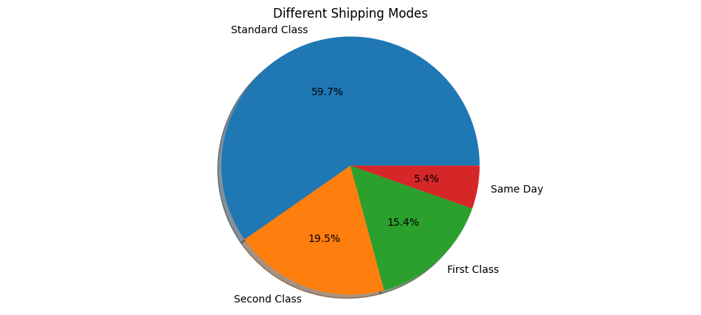
Shipping Modes Performance
In this Pie Chart, it is clear that Standard Class is the majority of shipping mode among the others, while Same Day shipping mode only shares a small portion. Also, it is shown that customers tend to use the shipping method with a lower price.
Customers tend to use the shipping method with a lower price

Slide 4
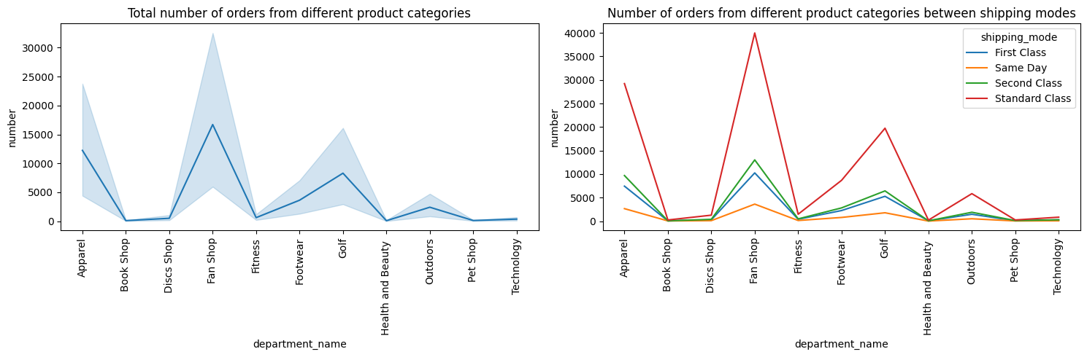
Engaging with Potential Clients
Most orders prefer using Standard Class service
Fan Shop, Apparel, and Golf products have the largest number of order in terms of all shipping modes.
Advice:
Sales Team can approach potential clients from Fan Shop, Apparel, and Golf industry.
Their customers also have higher chance to use premier shipping modes.

Slide 5
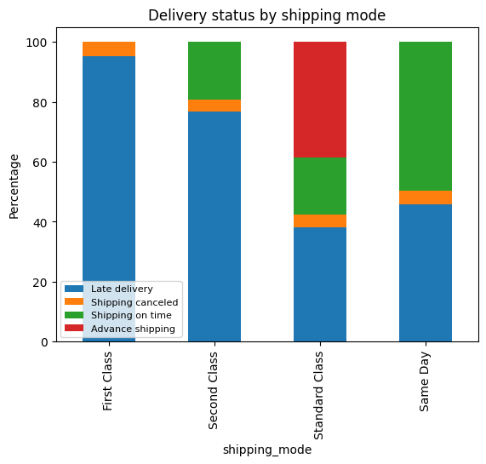
Supply Chain Performance by Shipping Modes
As the stacked Bar chart shown, the performance of all shipping modes is not so good.
In general, 40% of the orders are late delivery.
Almost 95% orders of First Class shipping mode are late delivery.
As a result, First Class and Second Class shipping modes require improvements in terms of supply chain to deliver orders on time
Summary:
First Class and Second Class shipping modes have serious late delivery problem

Slide 6
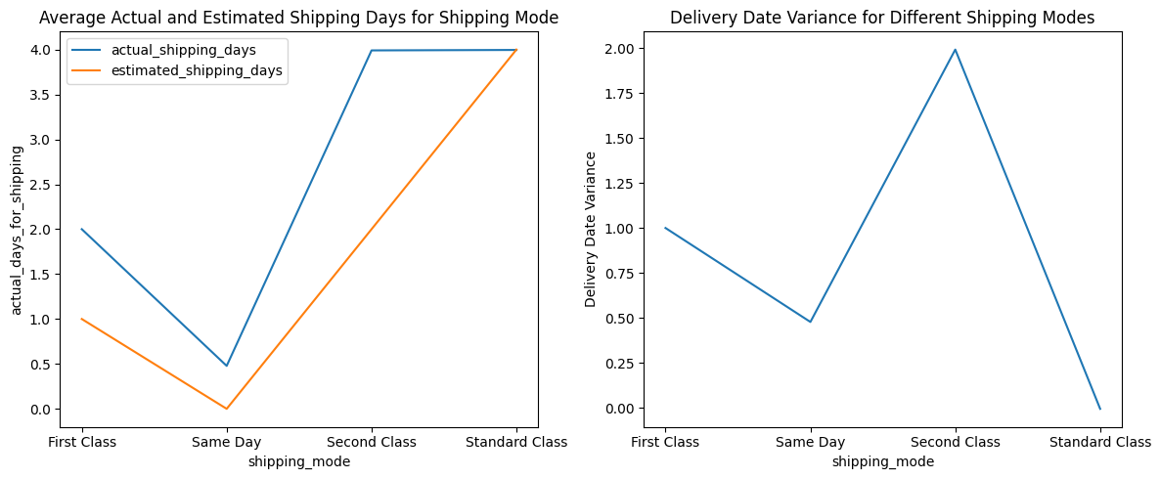
Shipping Days and Delivery Date Variance
First Class is very stable, which is always one day behind the schedule.
The performance of Same Day shipping mode is not bad as it has an average 0.5 days longer than expected.
Second Class has the most poor performance as it usually takes 1.5 days longer to complete the delivery, which is the longest among others. Besides, it has the largest maximum delivery date variance, which indicates that it has the longest delay.
Standard Class has the best performance as it usually delivers on time. Besides, it sometimes delivers earlier than expected.

Slide 7
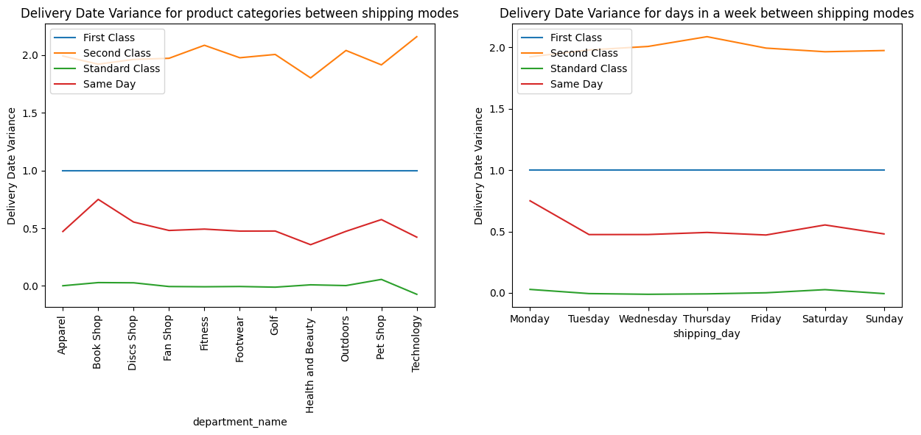
Delivery Date Variance in terms of Product Categories and Days of the week
Categories:
First Class shows a very stable delivery date variance to different categories
Technology products usually results in a longer delay than other products, when using the Second Class service.
Bookshop products usually takes longer time to arrive when comparing to the estimated days.
Standard Class has the best performance, which usually has no delay and its performance is not affected by different categories of products.
Days of the Week:
All shipping modes have similar performance in days of the week
Performance of Same Day shipping mode is affected the most on Monday, which results in delay.
Performance of Second Class is dropped on Thursday.

Slide 8
Summary
Customers Behaviors
Most orders prefer using Standard Class service
Fan Shop, Apparel, and Golf products have the largest number of order in terms of all shipping modes
Supply Chain Performance
First Class and Second Class shipping modes have serious late delivery problem
First Class is always one day behind the schedule
Second Class usually takes 1.5 days longer to complete the delivery
Second Class has the longest delay
Advice
Sales Team can approach potential clients from Fan Shop, Apparel, and Golf industry
Their customers also have higher chance to use premier shipping modes
Determine the root cause and solutions for supply chain performance

Slide 9



https://github.com/AHM2002/Supply_Chain_Analysis_Projects
https://www.linkedin.com/in/ahsanul-haque-milon-b4a33a225/

